Slide 1
SCBG 2023 Technical Call #1
Presented by Caitlin Hortert

Slide 2
Proposal Manual
Changes and Additions

Slide 3
Eligibility
Limit on active projects
Key personnel may not exceed 1.0FTE
*This applies for multiple applications in this round
Priorities
Building Consumer and Buyer Relationships
Strengthening Producer Networks and Associations
Regional and statewide education and marketing efforts
Marketing efforts to connect producers to buyers
Producer networking events
Capacity building
Use of available forums for producer connections

Slide 4
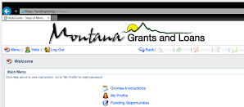
We are using WebGrants again!
Instructions on website if needed for creating account

Slide 5
Grant Management Manual
Updated and effective as of 1-1-2023 and will be discussed in the second tech call on March 8, 2023

Slide 6
Application Documents
Walkthrough and requirements

Slide 7
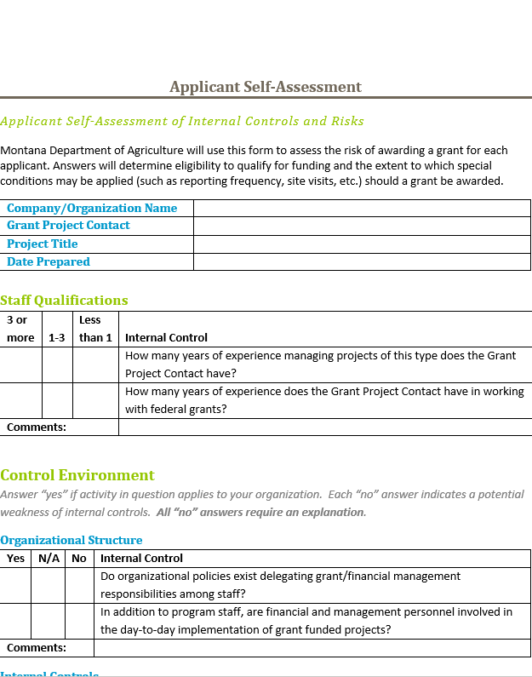
Self Assessment
Why? This form is to determine eligibility and project risk
Key Points
High risk does not mean you will not be awarded.
Answer all questions
Only add comments if they are necessary for understanding and consideration.
Please make sure the company you are applying under is the company that is being directly reimbursed.

Slide 8
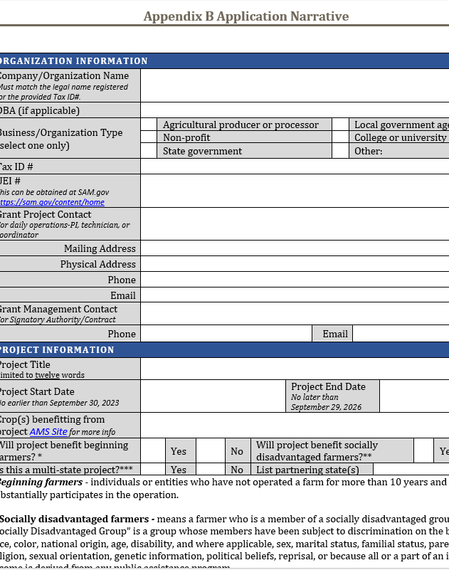
Application Narrative
Key changes
Research projects must put the maximum length for project completion
*Note: projects may not exceed past 9/29/2026
Simplified narrative for easier use if selected
Objectives: USDA preferred changes
Outreach: MDA section
Project funding: MDA section

Slide 9
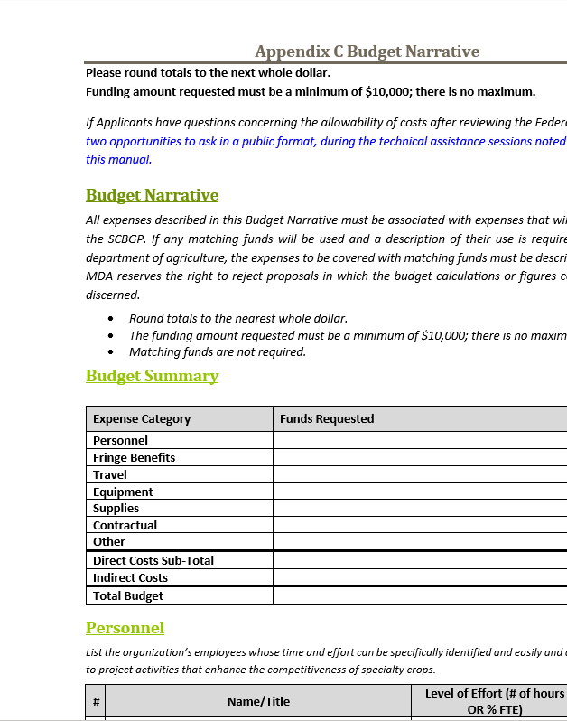
Budget Narrative
Key points
Format changed for easier transfer to USDA narrative
Personnel: No exceeding 1.0FTE
Travel: Organizational policies
Equipment: >$5000 (Buy or Rent)
Supplies: USDA specificity
Contractual: Will be USDA approved
Indirect: 5% of any personnel and fringe budget

Slide 10
Q&A
No question is a bad question!

